Slide 1

Web Services
Peter Alagna Jr.

Slide 2


Web Services
Any piece of software that makes itself available over the internet via a standard protocol or messaging system.
Available over the internet.
Uses a standardized messaging system.
It’s not tied to any operating system or programming language.
It’s self-describing via a common grammar.
It’s discoverable via a simple find mechanism.

Slide 3

Architecture Example
Google REST Authentication
Java Back-end
Spring REST Middle-end
HTTPS: JSON
Angular Client
HTTPS: JSON
HTTPS: XML
.NET SOAP Transaction Manager
C# Back-end
DB

Slide 4

Why do we use them?
Interoperability.
Make applications platform and technology independent.
Standardized media types.
XML, JSON, HTML.
Low cost of communication and delivery.
HTTP, HTTPS (REST).
HTTP, HTTPS, FTP and SMTP (SOAP).
Code reusability.
Connect other technologies to your existing one.
Distributed business applications.
Make your business system decoupled.
Service Oriented Architecture

Slide 5

Service Oriented Architecture (SOA)
Web services are an implementation of SOA.
Reuse
R
Integrate
I
SOA
Standardize
D
Deliver
D
Distribute
S

Slide 6
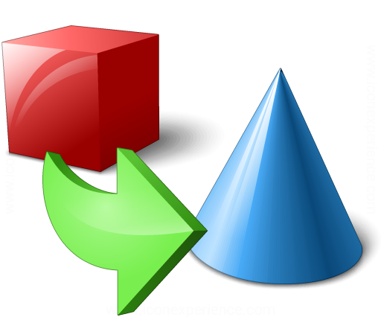
Marshalling
Process of transforming an object into a compatible version to be transmitted through the network.
POJO
Marshalling
JSON (String)
JSON (String)
Unmarshalling
POJO

Slide 7

JAX-B, JAX-WS, Jackson
Jackson.
JAX-B.
JAX-WS
JSON (String)
POJO
REST
XML
POJO
SOAP
WSDL
Java

Slide 8
Materials
Web Services: https://www.tutorialspoint.com/webservices/what_are_web_services.htm

